Slide 1


Slide 2
Safety

Slide 3
SAFETY PROTOCOLS
“Working safely may get old , but so do those who practice it”
Safety is the most important aspect of a chemical industries
All the employees must have proper training and information
about all the physical or health hazards in order to avoid them
As each chemical has unique hazards related to them, employees should always abide by a standard operating procedure(SOP) that addresses the use of correct personal protective equipment(PPE) safe handling, use and proper disposal.

Slide 4

Personal Protective Equipment

Slide 5
Fire Hazard
Fire hazards are the most common and one of the most dangerous hazards in a chemical industry.
Generally, fire is classified in four types :
Description | Class | Fire extinguisher
Combustible material (wood, paper etc.) | A | Water
Flammable liquids (petroleum, solvents etc.) | B | Foam
Gases (LPG etc.) | C | Co₂
Flammable metals (sodium, potassium etc.) | D | Dry chemical powder (DCP)

Slide 6
Fire Protection System
Vasant chemicals has a full fledged fire hydrant system in the plant. It has a 380KL water storage tank with a jockey, main and diesel pump for circulating the water when needed.
In case of power cut, diesel pump are used for fire fighting purposes
The main pump has an capacity of 270 KL per hour thus providing in house fire fighting 1.5 hours.
Apart from the fire hydrant system, various types of fire extinguishers are installed at various places

Slide 7
General Safety Protocols
Earthing should be insured while handling of solvents to avoid static electricity
Incase of any emergency assemble at assembling point
All employees are encouraged to report the unsafe conditions and unsafe acts so that immediate corrections are taken.
Accidents can be avoided by clear labeling of the containers and damage control can be done in case of spillage by providing proper spill absorption measures.
Harness should be used while working at heights.

Slide 8
A Safety Survey

Slide 9
Stores & Process Control Overview

Slide 10
Pre-Inspection
Material receipt
De-dusting & Quarantine
Sample intimation
Material Dispensing (FIFO)
Testing (Q.C)
Sample collection
GRN Preparation
Approval
In Process Check
Processing
Filtration
Drying and Shifting
Final Testing
Dispatch
Q.A Document verification
Packing and Labeling

Slide 11
Suggestions
Use of genuine software for all the activates especially Microsoft Windows® operating system and Microsoft office® as they come with latest security updates.
Using a standard layout scheme in the warehouses for better material movement and ease of identification.
All the systems in the plant are prone to malware and due to network sharing spreading of malware will be high effecting the systems present in the Head office, so a good Anti virus software like Quick heal, Avast or AVG must be used in every system

Slide 12
Maintenance

Slide 13
Boiler:
The plant has two Thermax boilers, one of 6 ton and the other one of 3 ton capacity.
Calculations :
Calorific value of coal | 4000kCal/kg
Pressure (steam) | 9kg/cm²
Enthalpy of steam (9Kg/cm² ) | 2774.22 kJ/kg
Enthalpy of water (32º C) | 155.50kJ/kg

Slide 14
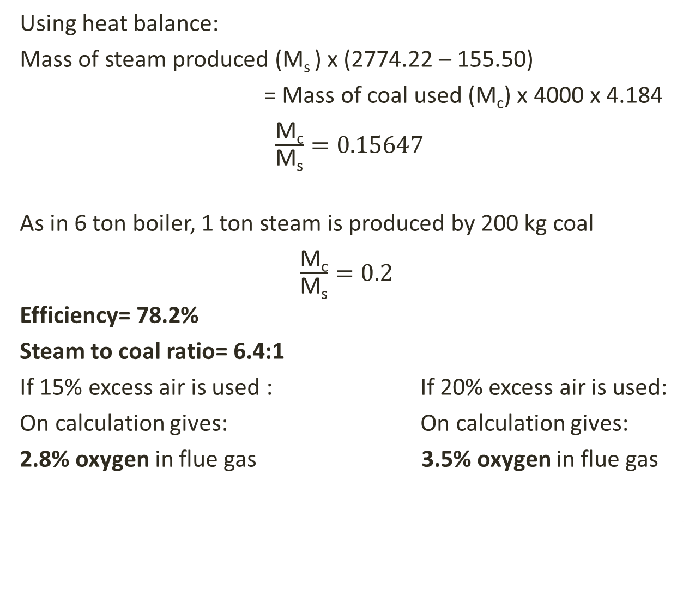
Using heat balance:
Mass of steam produced (M_{s} ) x (2774.22 – 155.50)
= Mass of coal used (M_{c}) x 4000 x 4.184
$\frac{\text{M}\text{c}}{\text{M}\text{s}}=0.15647$
As in 6 ton boiler, 1 ton steam is produced by 200 kg coal
$\frac{\text{M}\text{c}}{\text{M}\text{s}}=0.2$
Efficiency= 78.2%
Steam to coal ratio= 6.4:1
If 15% excess air is used : If 20% excess air is used:
On calculation gives: On calculation gives:
2.8% oxygen in flue gas 3.5% oxygen in flue gas

Slide 15
Suggestions
Wet coal: Wet coal decreases the efficiency of boiler to a huge extent, a proper storage of coal should be done. A underground storage could be possible with conveyor belts
Particle size(coal): For proper working of bed, coal size should be in the region of Geldart A to B which has a size of <0.5mm. As observed particle size is much larger.
Excess air: There is no proper benchmark for excess air, more air will absorb sensible heat while low value would give soot. A 15% excess air is usually suitable for boiler.

Slide 16
Chiller plant:
It is installed to cater the demand of chilled methanol brine in the production block.
It works on the principle of simple refrigeration cycle which utilizes ammonia(R717) as a refrigerant
Calculations :
When a single compressor is running
ΔT = 3.5 K
Therefore,
TR load = M C ΔT /3.5 kW
TR = 35 x 937.5x 3.01x 3.5/(3600x 3.5)
=27.43
Similarly when both compressors are running,
TR = 46.09

Slide 17
Nitrogen plant:
Nitrogen generation plant is based on Pressure Swing Adsorption(PSA) process that consists of two adsorbers filled with carbon molecular sieve (CMS).
Compressed purified air is passed through CMS where oxygen is adsorbed on the CMS.
Air is passed through only one of the adsorber
In the next step, air is passed from the other adsorber while the previous adsorber is vented off for its regeneration

Slide 18
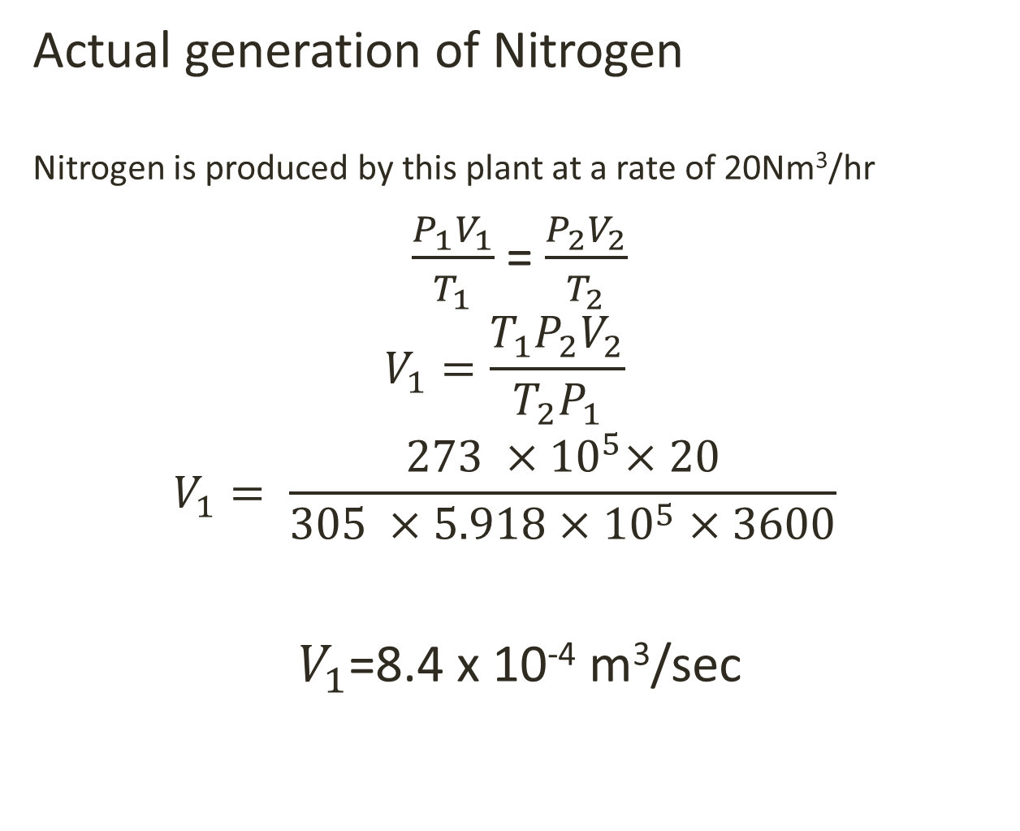
Actual generation of Nitrogen
Nitrogen is produced by this plant at a rate of 20Nm³/hr
$\frac{P_{1}V_{1}}{T_{1}}$= $\frac{P_{2}V_{2}}{T_{2}}$
$$V_{1}=\frac{T_{1}P_{2}V_{2}}{T_{2}P_{1}}$$
$$V_{1}= \frac{273 {×10}^{5}×20}{305 ×5.918×{10}^{5}×3600}$$
$V_{1}$=8.4 x 10⁻⁴ m³/sec

Slide 19
Suggestions
Flow meter which is installed in Nitrogen generation plant showing 28 Nm³/hr while its capacity is 20 Nm³/hr.
One reason could be the malfunctioning of CMS which could have resulted in low purity of nitrogen.
As the flow meter is calibrated for nitrogen, it is showing higher flow rate for relatively higher massed oxygen.

Slide 20
Multi Effect Evaporator & ATFD

Slide 21
The multi effect evaporator plant is a triple effect evaporator with a feed forward arrangement.
The preheated feed is feed to the first effect calandria
Dry saturated steam is used as a heating medium which causes evaporation from feed liquid in the calandria.
Vapour generated in the first effect is used as a heating medium in the second calandria and so on.
Product with more solid content is taken out from the last effect.
Vapours from the last effect are condensed in a surface condenser

Slide 22
Agitated Thin Film Dryer
Concentrated product received from the evaporation plant is feed to ATFD.
Feed is uniformly distributed over the inner surface of the dryer shell of ATFD.
The feed forms a tin film by the continuous agitator type scrapper blades specially designed for this.
Steam is provided in the outer shell and dry product comes down from the inner shell surface with a moisture content of just 8-10%.
The dry product being hazardous is landfilled for safe disposal.

Slide 23
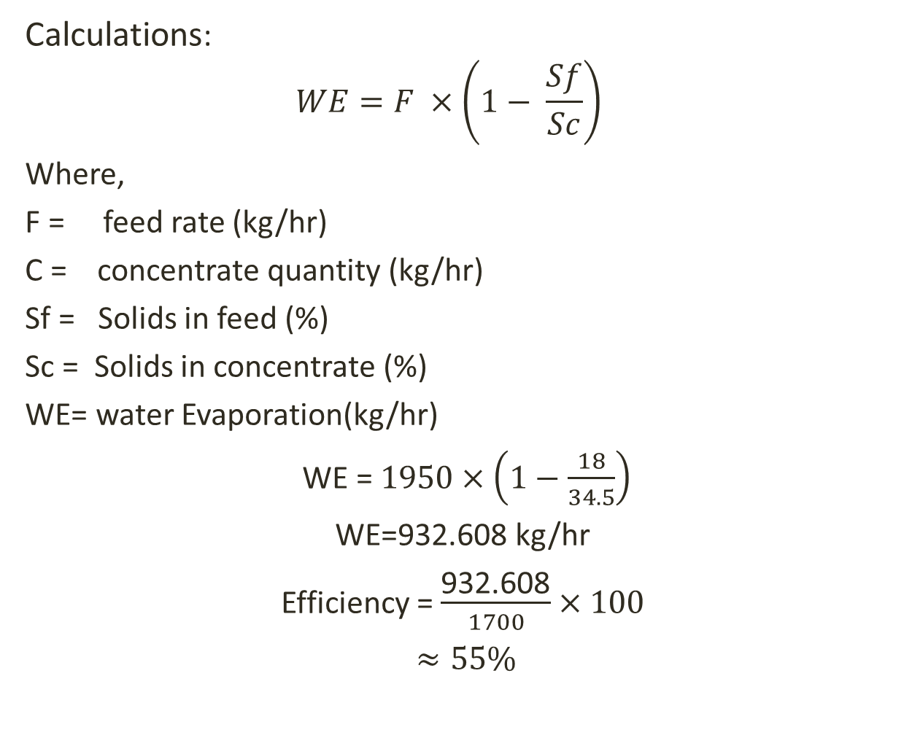
Calculations:
$$WE=F ×\left(1− \frac{Sf}{Sc}\right)$$
Where,
F = feed rate (kg/hr)
C = concentrate quantity (kg/hr)
Sf = Solids in feed (%)
Sc = Solids in concentrate (%)
WE= water Evaporation(kg/hr)
WE = $1950×\left(1−\frac{18}{34.5}\right)$
WE=932.608 kg/hr
Efficiency = $\frac{\text{932.608}}{1700}×100$
$≈55\%$

Slide 24
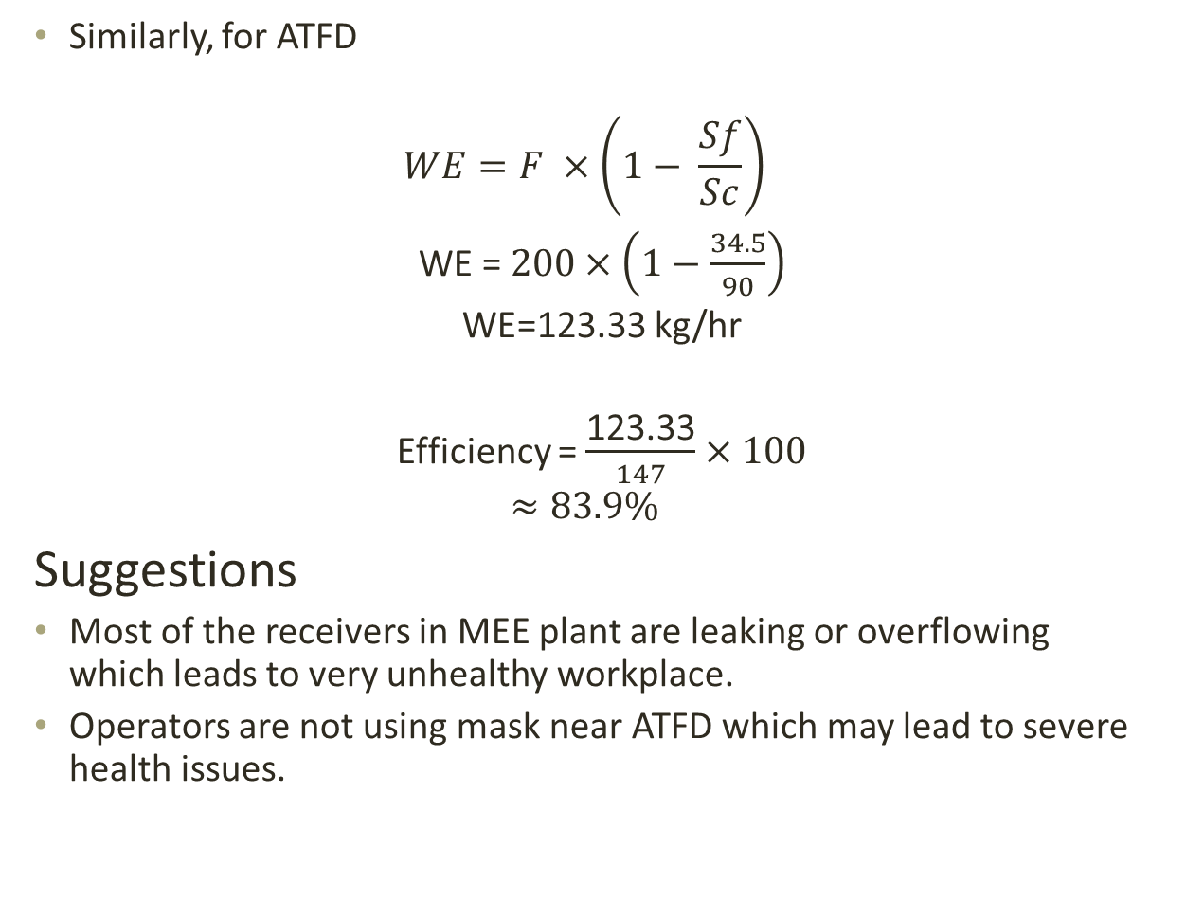
Similarly, for ATFD
$$WE=F ×\left(1− \frac{Sf}{Sc}\right)$$
WE = $200×\left(1−\frac{34.5}{90}\right)$
WE=123.33 kg/hr
Efficiency = $\frac{\text{123.33}}{147}×100$
$$≈83.9\%$$
Suggestions
Most of the receivers in MEE plant are leaking or overflowing which leads to very unhealthy workplace.
Operators are not using mask near ATFD which may lead to severe health issues.

Slide 25
Biological Treatment Plant

Slide 26
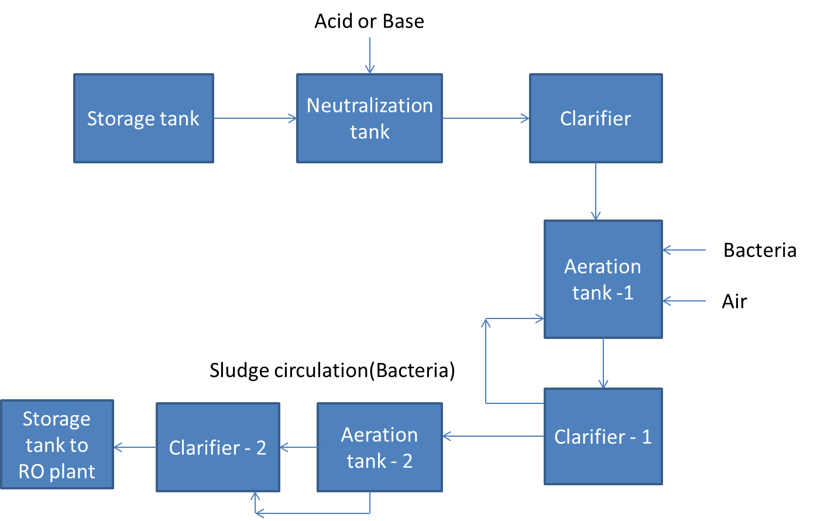
Flow chart for Biological Treatment Plant

Slide 27
Sand bed
Sand
Stones
carbon
Treated water from BTP
Bag filter
Pre filter
pump
Permeate
Membrane module
Retentate

Slide 28
The Biological treatment plant installed has following steps for waste water treatment.
Neutralization tank
primary clarifiers
Aerator
Secondary clarifiers
RO plant
Calculations:
*All the dates are in ppm
Measuring point | pH | TDS | TSS | COD | BOD
Std. Limit | 7.5-8.5 | <4000 | <200 | <4000 | <1200
BTP INLET | 7.89 | 3204 | 158 | 1869
BTP OUTLET | 8.17 | 2914 | 58 | 28.5

Slide 29
Production

Slide 30
Production
Catalyst
DM water
Reactant A
Reaction
Distillation
Dilution
Reactant B
Substance A or B
Crystallization
Packing
Size Reduction
Drying
Filtration
Filtration MLS

Slide 31

Yield :
ME₃TACN Product:
Batch Size = 500 kg ( ME₃ Raw Material)
Theoretical Product = 121.17 kg
Actual Product = 118 kg
Yield(theoretical ) = $\frac{121.17 kg}{500 kg}$ = 0.24
Yield(practical ) = $\frac{118 kg}{500 kg}$ = 0.236

Slide 32

4 - Amino Benzo Nitrile(4-ABN):
Batch Size = 200 kg (PAB key Raw Material)
Theoretical Product = 147 kg
Actual Product = 130 kg
Yield ( actual ) = $\frac{130 kg}{200 kg }$ = 0.65
Yield ( theoretical ) = $\frac{147 kg}{200 kg }$ = 0.735

Slide 33
Production Planning:
At the beginning of the last weeks of month, marketing team provide a tentative dispatch schedule for the following month.
Manufacturing incharges identify the production capacity of each unit based on the dispatch schedules, plant maintenance and breakdowns.
Manufacturing incharges will review the dispatch schedule, confirm the same based on the monthly production plan, stock of the product and inform to the marketing team.
Marketing team inform to the relevant customers about the amended dispatch dates.

Slide 34
Production planning can be classified as:
1. Input planning
2. Output planning
Input planning : Frequency of batch
Output planning: Total duration of batch (output)
R & D will provide tech pack, based on this production incharges will prepare BPCR. If process needs any improvement after formation of BPCR, they will take CCF.
Formed BPCR will approved by QA department.
Based on the BPCR production employee will feed the raw materials and note the readings( time, temp,…).
Again QA will approve the final BPCR.
DISPATCH

Slide 35
Suggestions:
Use ball mills for reducing lumps(Size reduction).
Granular Activated Carbon(GAC) can be regenerated. So we can use GAC in process.

Slide 36
Projects

Slide 37
User Requirement Sheet:
1. Which type
2. Suitable MOC
3. Operating hours
4. Utilities required
5. Other requirements ( nozzle size etc.)
After receiving URS, we will get the quotation from vendors. In quotation we will check :
1. Equipment quality
2. Delivery date
3. Specification will meet or not ??
4. Cost

Slide 38
Qualifications:
1. Design Qualifications:
Capacity, MOC, Shell diameter etc.
2. Installation Qualifications:
Installation will done based on design
3. Operational Qualification:
Equipment's(Nozzles, valves, reactor etc.) checking at design specifications
4. Performance Qualification:
Trail runs will do

Slide 39
Standard procedure for Projects:
PLF (Details of project, purpose of project, Target date, cost)
Material estimation/Equipment cost/ Labor cost
After raising PLF, will get approval from MD.
After getting approval, indent will raise.
Purchase Order
GRN
Project Execution
Handover to UR department
Suggestions:
We can use Critical Path Method(CPM), PERT analysis for executing proper project management. By using this methods, we can reduce project cost and time duration.

Slide 40
General Suggestions:
Smell removal from MEE or PB1 : Bio filter, exhaust system(proper ventilation).
Flocculants removal can be possible by polyelectrolytes for BTP.
Trickling filter can also be used for water treatment.
Chilling plant: Fouled tubes, leaking refrigerant.
Cooling towers:
Better cooling tower control by Minimizing blow down monitoring conductivity.
pH/alkalinity control to minimize scale formation.
Decreasing feed hardness, iron, and silica.
Manage microbial growth.
For blow down, post treatment in the form of reverse osmosis or ion exchange can prove extremely beneficial.

Slide 41
RO plant :
Avoid chlorine in water ( because will damage the polyamide membrane).
Membrane regeneration by using citric acid.
Activated carbon regeneration ( by using steam).
Silver impregnated Activated carbon .
Ion exchange beds for decreasing hardness.

Slide 42
Thank You

